Slide 1
Advanced Robotics
Pradeep Roy(py160) | Jawahar Pinnelli(jp2141)

Slide 2
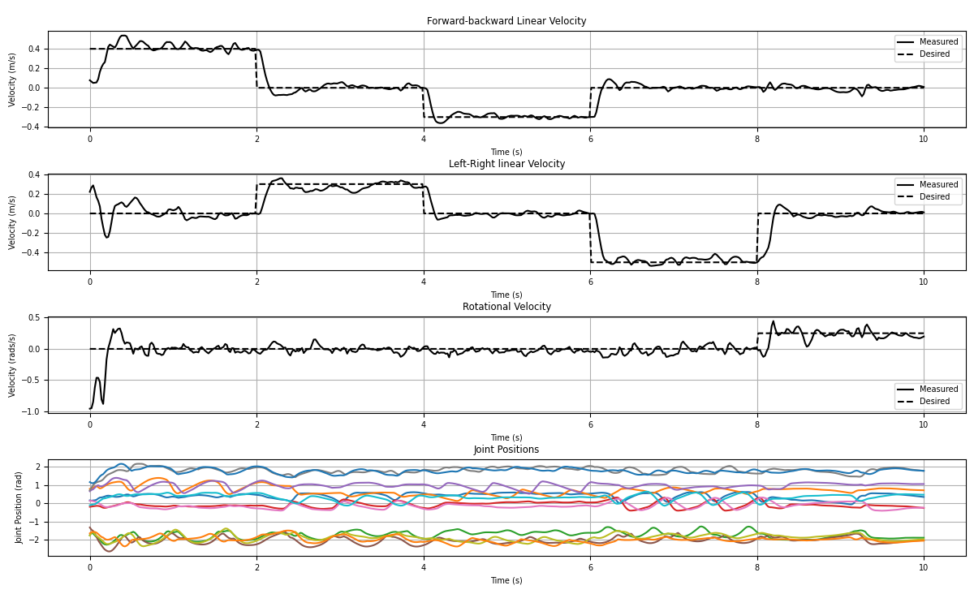
Plots :

Slide 3

Video:

